Slide 1
CDGC
Load CDGC Metadata into SQL
Prototype

Slide 2
What are we trying to do?
This will bulk load any/all metadata into a SQL Database (snowflake, databricks, sqlserver, oracle, mysql, postgres)
This might be useful for BI reporting, where complex queries are required.

Slide 3
CDGC
Load CDGC Metadata into SQL
Prototype
Setup & Running

Slide 4
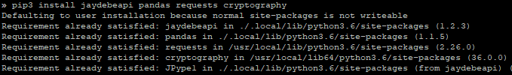
Setup Step 1
Using "pip" ensure the required libraries are installed
pip install jaydebeapi pandas requests cryptography
or
pip3 install jaydebeapi pandas requests cryptography

Slide 5
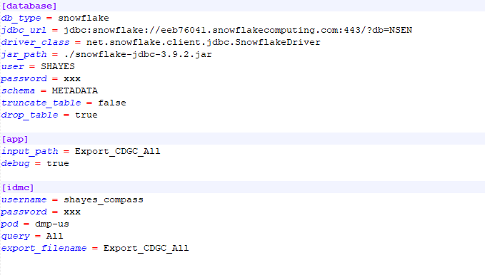
Setup Step 2
Modify the config.ini as needed
Specify database type (snowflake, databricks, sqlserver, oracle, mysql, postgres)
Specify JDBC Connection String, JDBC Class Name, JDBC Jar path, JDBC User and Password
Specify the Schema where tables will be created
If tables already exist should the script truncate or drop the tables?
Name of the file (minus extension). Depending on the size of the export, it will either export a zip file or an xlsx. “input_path” should match “export_filename”
Debug. If set to true, it will log all statements before it executes
IDMC Username (local user) and password
IDMC POD
Query to run for the export (“All” for all objects)
Name of the file (minus extension). Depending on the size of the export, it will either export a zip file or an xlsx. “input_path” should match “export_filename”

Slide 6

Setup Step 3
Right now, this script uses a JDBC connection, so ensure that you have a JAVA_HOME set

Slide 7
Running
The solution is divided into two separate scripts. This is done so that someone can use part of the functionality independently. Examples: If you want to quickly use the script to export. Use a script to import any excel file, etc.
extract_from_idmc.py – This will read the config.ini, execute the query, wait for the job to finish, and download the resulting zip or xlsx file
load_excel.py – This will read the config.ini, connect to the database, and replicate all worksheets in the xlsx file (or xlsx file within the zip file) specified, using the logic of the database specified
For convenience, a shell script is also specified (load_metadata.sh) to automatically run these two scripts together. You’ll need to modify this script for path

Slide 8
Running extract_from_idmc.py
Sample Output:
Running extract_from_idmc.py Version 20250613
Logged in. Session ID: kDXd8ErNVm8lVYxkwGVBwl, Org ID: c5Py7N4kfSAkhK7uo5sl6u
Generated JWT token
Started export job. Job ID: b2d40c9d-3cce-491c-8d57-26ea962509db
Job status: STARTING
Job status: STARTING
Job status: RUNNING
Job status: RUNNING
Job status: RUNNING
Job status: RUNNING
Job status: RUNNING
Job status: RUNNING
Job status: RUNNING
Job status: COMPLETED
Job completed
Export_CDGC_All.xlsx

Slide 9
Running extract_from_idmc.py
Sample Output:
Running load_excel.py Version 20250613
[DEBUG] Executing SQL:
SELECT * FROM INFORMATION_SCHEMA.TABLES
WHERE TABLE_SCHEMA = 'METADATA' AND TABLE_NAME = 'Technical_Data_Set'
[DEBUG] Executing SQL:
DROP TABLE "METADATA"."Technical_Data_Set"
Dropping table "METADATA"."Technical_Data_Set"
Creating table Technical_Data_Set in schema METADATA
[DEBUG] Executing SQL:
CREATE TABLE "METADATA"."Technical_Data_Set" ("Reference ID" VARCHAR, "Name" VARCHAR, "Catalog Source Name" VARCHAR, "Catalog Source Type" VARCHAR, "Parent: Technical Data source" VARCHAR, "Parent: Technical Data Set" VARCHAR, "Parent: Look" VARCHAR, "Asset Type" VARCHAR, "Description" VARCHAR, "Technical Description" VARCHAR, "Lifecycle" VARCHAR, "Business Name" VARCHAR, "Glossaries: Recommended" VARCHAR, "Glossaries: Accepted" VARCHAR, "Glossaries: Rejected" VARCHAR, "Data Classifications: Accepted" VARCHAR, "Data Classifications: Rejected" VARCHAR, "Reference" BOOLEAN, "Stakeholder: Governance Administrator" VARCHAR, "Stakeholder: Governance Owner" VARCHAR, "Stakeholders Type" VARCHAR, "HierarchicalPath" VARCHAR, "Operation" VARCHAR, "Created On" VARCHAR, "Created By" VARCHAR, "Modified On" VARCHAR, "Modified By" VARCHAR, "Identity" VARCHAR, "core_Location" VARCHAR, "core_Origin" VARCHAR)
Inserting data into Technical_Data_Set in schema METADATA
[DEBUG] Executing SQL:
INSERT INTO "METADATA"."Technical_Data_Set" ("Reference ID", "Name", "Catalog Source Name", "Catalog Source Type", "Parent: Technical Data source", "Parent: Technical Data Set", "Parent: Look", "Asset Type", "Description", "Technical Description", "Lifecycle", "Business Name", "Glossaries: Recommended", "Glossaries: Accepted", "Glossaries: Rejected", "Data Classifications: Accepted", "Data Classifications: Rejected", "Reference", "Stakeholder: Governance Administrator", "Stakeholder: Governance Owner", "Stakeholders Type", "HierarchicalPath", "Operation", "Created On", "Created By", "Modified On", "Modified By", "Identity", "core_Location", "core_Origin") VALUES (?, ?, ?, ?, ?, ?, ?, ?, ?, ?, ?, ?, ?, ?, ?, ?, ?, ?, ?, ?, ?, ?, ?, ?, ?, ?, ?, ?, ?, ?)

Slide 10
Thank You
Questions / Issues / Suggestions:
Scott Hayes
shayes@informatica.com

